Slide 1
Session 2
Cloud’s properties and Architecture

Slide 2
Objectives
Cloud Ecosystem
Requirements for Cloud Services
Benefits and Drawbacks of cloud computing
Cloud Architecture
Applications on Cloud

Slide 3
Cloud Ecosystem
The cloud ecosystem of interacting components and organizations with individuals, together known as the actors who could be responsible for either providing or consuming cloud services, can be categorized in the following manner
Cloud service users (CSUs): A consumer (an individual/person), enterprise (including enterprise administrator), and/or government/public institution or organization that consumes delivered cloud services;
Cloud Service Provider(CSPs): An organization that provides or delivers and maintains or manages cloud services, that is, provider of SaaS, PaaS, IaaS, or any allied computing infrastructure
3. Cloud service partners (CSNs): A person or organization (e.g., application developer; content, software, hardware, and/or equipment provider; system integrator; and/or auditor) that provides support to the building of a service offered by a CSP (e.g., service integration).

Slide 4
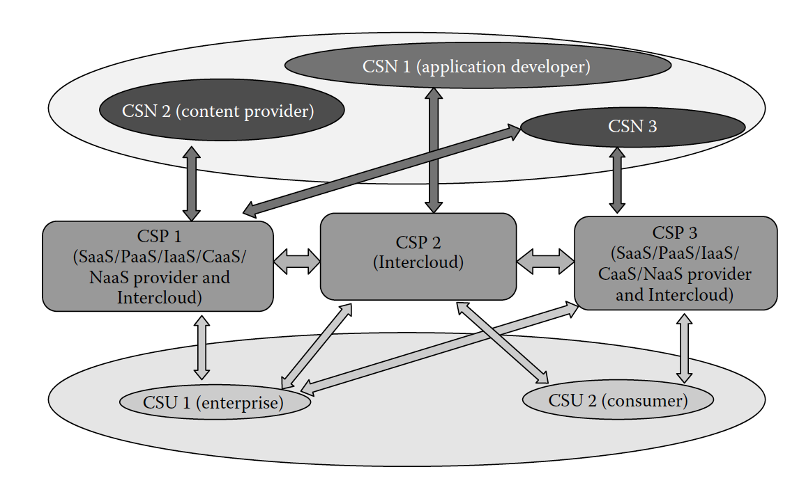
Actors with some of their possible roles in a cloud ecosystem

Slide 5
Requirements for Cloud Services
Multitenancy: Multitenancy is an essential characteristic of cloud systems aiming to provide isolation of the different users of the cloud system (tenants) while maximizing resource sharing
Service life cycle management: Cloud services are paid as per usage and can be started and ended at any time
Security: The security of each individual service needs to be protected in the multitenant cloud environment

Slide 6
Requirements for Cloud Services
Responsiveness: The cloud ecosystem is expected to enable early detection, diagnosis, and fixing of service-related problems in order to help the customers use the services faithfully.
Intelligent service deployment: It is expected that the cloud enables efficient use of resources in service deployment, that is, maximizing the number of deployed services while minimizing the usage of resources and still respecting the SLAs
Notes:
SLA: SLAs are a set of agreements that are signed between the user and service providers (see Section 3.8.1).

Slide 7
Requirements for Cloud Services
More to discuss such as: Interoperability, Regulatory aspects, Environmental sustainability, Service reliability, Service access, Flexibility, Accounting and charging, Massive data processing

Slide 8
Benefits and drawbacks of cloud computing
Discussion in group about this, more hints can be found at page 23 of the book.
More can be look at https://www.youtube.com/watch?v=KVydGQGR1Lo

Slide 9
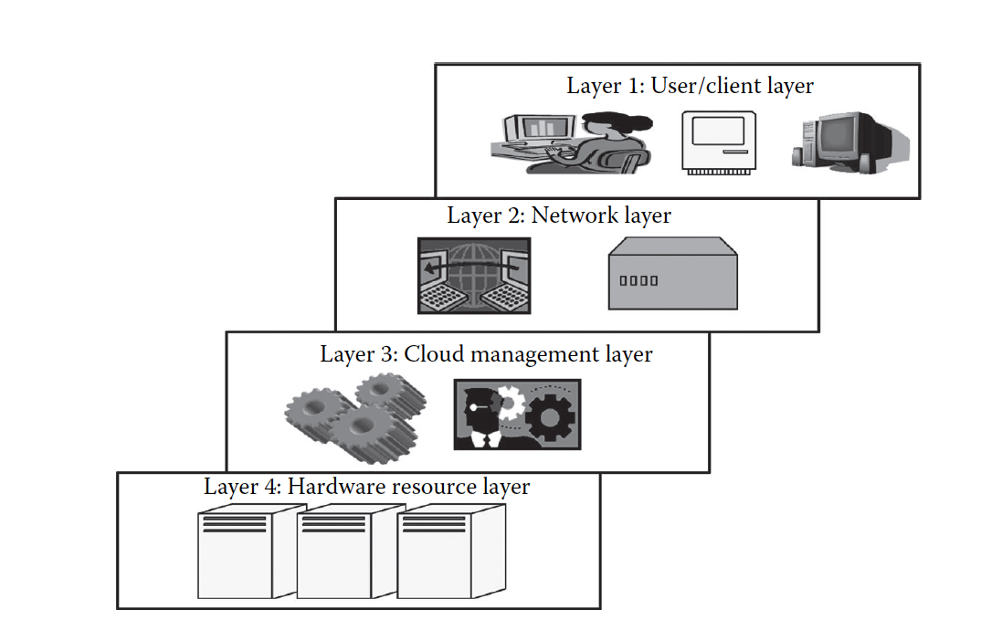
Cloud architecture
Cloud architecture consists of a hierarchical set of components that collectively describe the way the cloud works

Slide 10
Layer 1 (User/Client Layer)
This layer is the lowest layer in the cloud architecture. All the users or client belong to this layer.
The client can be any device such as a thin client, thick client, or mobile or any handheld device that would support basic functionalities to access a web application

Slide 11
Layer 2 (Network Layer)
This layer allows the users to connect to the cloud
This is primarily the Internet in the case of a public cloud
In the case of a private cloud, the connectivity may be provided by a local area network (LAN).
This layer does not come under the purview of service-level agreements (SLAs)

Slide 12
Layer 3 (Cloud Management Layer)
This layer consists of softwares that are used in managing the cloud
The softwares can be a cloud operating system (OS), a software that acts as an interface between the data center (actual resources) and the user, or a management software that allows managing resources.
This layer comes under the purview of SLAs

Slide 13
Layer 4 (Hardware Resource Layer)
Layer 4 consists of provisions for actual hardware resources.
In the case of a public/private cloud, a data center is used in the back end
This layer comes under the purview of SLAs.
Whenever a user accesses the cloud, it should be available to the users as quickly as possible and should be within the time that is defined by the SLAs

Slide 14
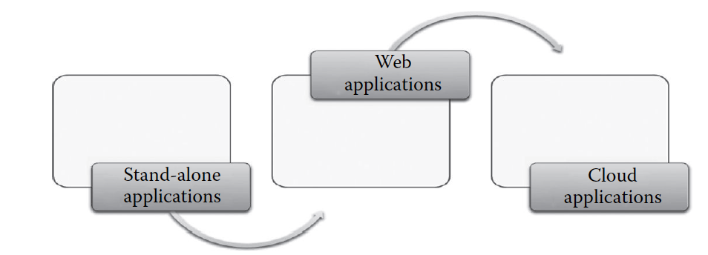
Applications on the Cloud
The first type of applications that was developed and used was a stand-alone application.
A stand-alone application is developed to be run on a single system that does not use network for its functioning.
The web applications were different from the stand-alone applications in many aspects
The main difference was the client server architecture that was followed by the web application
Unlike stand-alone applications, these systems were totally dependent on the network for its working.

Slide 15
Shortcomings of web application
The web application is not elastic and cannot handle very heavy loads
The web application is not multitenant
The web application does not provide a quantitative measurement of the services that are given to the users, though they can monitor the user
The web applications are usually in one particular platform
The web applications are not provided on a pay-as-you-go basis
Due to its nonelastic nature, peak load transactions cannot be handled

Slide 16
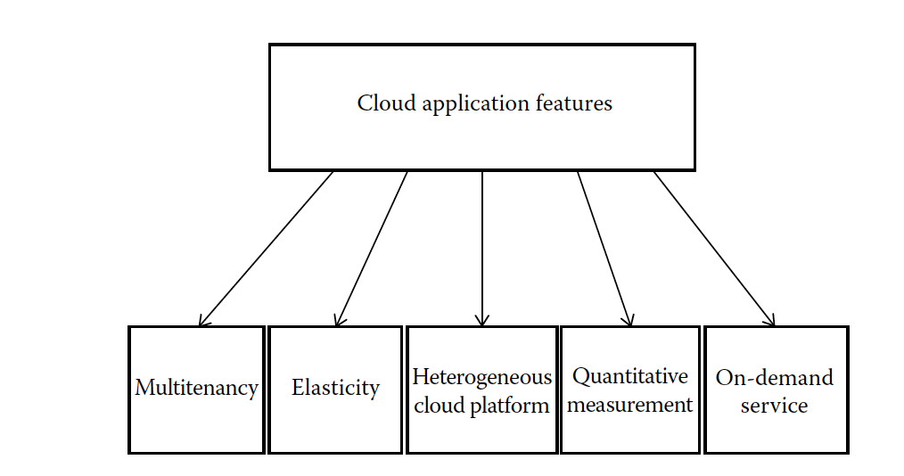

Slide 17
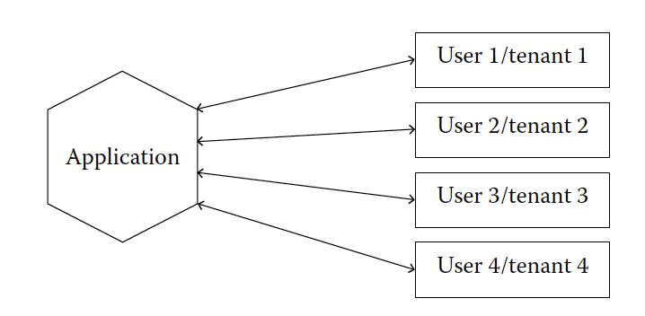
Multitenancy
Software can be shared by different users with full independence. Here, independence refers to logical independence
Each user will have a separate application instance and the changes in one application would not affect the other
Physically, the software is shared and is not independent

Slide 18
Multitenancy discussion
Look at the video and discuss why mutitenancy is not always the best
https://www.youtube.com/watch?v=WY1CWROPAU8

Slide 19
Elasticity
Elasticity can be defined as the degree to which a system is able to adapt to workload changes by provisioning and deprovisioning resources in an autonomic manner such that at each point in time
Elasticity allows the cloud providers to efficiently handle the number of users, from one to several hundreds of users at a time

Slide 20
Elasticity discussion
Discuss what Amazon’s E2C can offer interm of Elastic by watching the video
https://www.youtube.com/watch?v=TsRBftzZsQo

Slide 21
Heterogeneous cloud platform
The cloud platform supports heterogeneity, wherein any type of application can be deployed in the cloud
The applications that are usually deployed can be accessed by the users using a web browser

Slide 22
Quantitative measurement
The services provided can be quantitatively measured
The user is usually offered se
Not only the services are measureable, but also the link usage and several other parameters that support cloud applications can be measured prices based on certain charges

Slide 23
On-demand service
The cloud applications offer service to the user, on demand, that is, whenever the user requires it.
The cloud service would allow the users to access web applications usually without any restrictions on time, duration, and type of device used

Slide 24
Summaries
Cloud Ecosystem
Requirements for Cloud Services
Benefits and Drawbacks of cloud computing
Cloud Architecture
Applications on Cloud

